Slide 1


Modeshift TravelWise Week
In conjunction with

Slide 2


Join in
Join us and travel wisely with a
Walk,
Wheel or
Ride
to help create healthier, cleaner, greener and safer places for everyone!

Slide 3





Go for a walk or wheel
Go for a walk or wheel
Walking and wheeling are great ways to travel more actively.
It helps to keep you fit,
being outdoors helps boost your mental health
especially if you can walk and wheel with others and chat along the way,
and it’s environmentally friendly too!
Ways to celebrate walking and wheeling during Modeshift Travelwise week
If you can, swap a car journey for a walk and wheel to school, the shops or any other place.
Go on a walking and wheeling discovery trail to find out what your local area has to offer.
Organise an active travel breakfast to encourage walking and wheeling.

Slide 4





Go for a cycle ride
Go for a cycle ride
If it’s too far to walk and wheel, why not try a cycle ride!
It gets your heart pumping and your muscles moving
and is a fume free way to travel.
Ways to celebrate cycling during Modeshift TravelWise week
Get ready to ride with cycle training or cycle maintenance with Dr Bike
Pledge to join at cycle challenge like Cycle to School week
Go for a ride to school, the shops or any other place, or just for fun!

Slide 5


Get a ticket to ride!
Get a ticket to ride!
Buses and trains can transport a lot more passengers than cars
they save the hassle of finding somewhere to park
and you are less likely to get stuck in a traffic jam!
Ways to celebrate public transport during Modeshift TravelWise week
Checkout if there are any local public transport services near you and the places you travel.
Lookout for any special ticket deals and go for a bus or rail ride.
If the entire journey isn’t possible by public transport can you Park and Ride?

Slide 6



Share the ride
Share the ride
Reducing the number of cars on the road can help make the air cleaner,
reduce carbon emissions
and make it easier for walkers, wheelers and cyclists.
Ways to celebrate greener and cleaner roads during Modeshift TravelWise week
If travelling by car is the only option and you are travelling in the same direction as someone else can you give them a lift and car share?
Can you help create a fume free zone by switching off your engine or leave the car further away and Park and Stride, roll, glide or ride?

Slide 7

Organise a walk, wheel, ride day
If you can only do one thing
combine everything together for a
Walk, Wheel and Ride Day
on any day of the week 16-20th September

Slide 8
Design a mascot
If you can only do one thing
design a
mascot

Slide 9
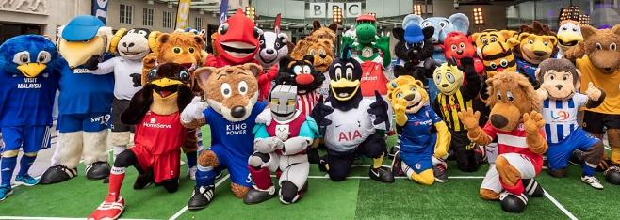
What is a mascot?
What is a mascot?
A mascot is any human, animal, or object thought to bring luck, or anything can be used to represent a group like a sports team, a school, a company or a product.
The word 'mascot’ comes from the French word 'mascotte' which means lucky charm.
Do you recognise any of these mascots?
Notes:
Do pupils recognise any of the football mascots shown and which team they represent?
Do they know their names?
Do they know any other mascots?
Where from?
Does your school have a mascot?

Slide 10
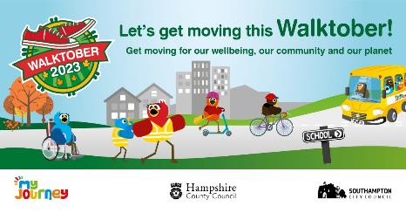

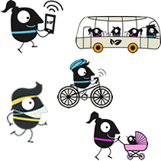


Meet some other travel mascots
Meet some other travel mascots
These mascots are used to encourage walking, cycling, wheeling, car sharing and using public transport in this country and abroad.
Terry the Tiger
Birds
European Mobility Week
Miles
Living Streets Strider
Notes:
An extension activity could be to Google other travel mascots
Discuss why the character might have been chosen

Slide 11









Meet the Team Modeshift STARS mascots
Meet the Team Modeshift STARS mascots
What shape are all the characters?
Why do you think this shape was chosen?
Notes:
Did you know that STARS stands for Sustainable Travel Accreditation Recognition Scheme ( that’s lots of complicated words to mean an award for active, safe and environmentally friendly travel)
What else are “stars” associated with i.e. positive things, good work – gold star, a superstar, film stars, Hollywood stars, some people even have ‘real stars’ named after them!

Slide 12









Think of words to describe mascots
Think of words to describe how the Modeshift STARS mascots move
wheeler
walker
strider
stroller
glider
rider
roller
Can you think of any other words?
Which word or words would you choose to describe each character?
Notes:
Use a thesaurus to find other synonyms for moving - jogger, runner, bouncer, skipper, hiker,
Does the character need a “qualifying” mode – ie STAR bus rider, STAR cycle rider (there’s no right or wrong answer)

Slide 13
Activity ideas 1 & 2
Activity ideas with the Team Modeshift STARS mascots
Activity 1
Can you design more TeamModeshift STARS mascots to represent you or other people and the way they do or would like to travel?
Think about people who are older or younger.
Think about all different ways of moving.
Does your character have a name?
Share your ideas with others – create a display, a PowerPoint or take a photo to share online.
Activity 2
Design a STARS school.
What needs to be at a STARS school so that all the TeamModeshift STARS mascots can travel there in active, safe and environmentally friendly ways?
Are there places to store cycles, scooters?
And there walking and wheeling routes around STARS school?
Are there places for vehicles – are all vehicles allowed?
What other things we help make the STARS school an active, attractive and environmentally place to learn?
Draw a picture or build a model of the perfect STARS school.
Notes:
These are just ideas – you don’t have to do them all and you might have better ideas!
If your school is on social media share your artwork, ideas, models with @be_travel_smart and @TeamModeshift on X

Slide 14
Activity ideas with the Team Modeshift STARS mascots activity 3 and 4
Activity 3
Design a STARS town.
How do the Modeshift STARS mascots get from where they live to STARS School?
Are there cycle routes, walking and wheeling routes, places for cars and buses?
How do STARS people get to the shops, the park, leisure centre or other places further away?
Expand your STARS school map or model to create a STARS town which allows all the Modeshift STARS mascots to move around easily, safely and in environmentally friendly ways.
Activity 4
Design a Super STARS certificate to encourage people to travel in safe, active and environmentally friendly ways.
Think about how to include everyone and ever way of travelling.
Which certificate could you earn and for doing what?
Super STAR Walker, Super STAR Wheeler, Super STAR Rider (bus, cycle, taxi or car)
Notes:
Think about all the elements of making a journey – every part could be worthy of an award – using a crossing, walking with others, planning a public transport journey, paying a fare, putting on a seatbelt, fastening a helmet

Slide 15

Activity ideas with the Team Modeshift STARS mascots 5
Activity 5
Create your own school mascot for active, safe and environmentally friendly travel.
Is your mascot a person, an animal or even an object?
Does your mascot have a name?
Could you make your mascot into something 3D – a puppet, a toy, a mask or even a costume?
How would you use your mascot to encourage active, safe and environmentally friendly travel?
Tell us all about your mascot!
Notes:
Could children take the mascot on a journey?
Could the mascot keep a diary of their travels – through photographs, written or recorded words
Could the mascot be awarded to the class or person who has earned a Super STARS award?

Slide 16
How to join in with Modeshift TravelWise Week
Pledge and register at https://modeshift.org.uk/travelwise-week/
Tell us who you are and where you are from and how you plan to take part
Share your pledge and Modeshift TravelWise Week activities with us on social media with #TravelWiseWeek #TravelWisely #WalkWheelRide
You can also
Complete initiatives towards your Modeshift STARS accreditation
Record as STARS Education initiative – PR28 – Participation in Modeshift TravelWise Week
Plus any other initiatives you undertaken
You can also enter the national Modeshift TravelWise Week awards

Slide 17
We look forward to you joining us
We look forward to you joining us!
#TravelWisely with a
Walk,
Wheel or
Ride
to help create healthier, cleaner, greener and safer places for everyone!

