Slide 1
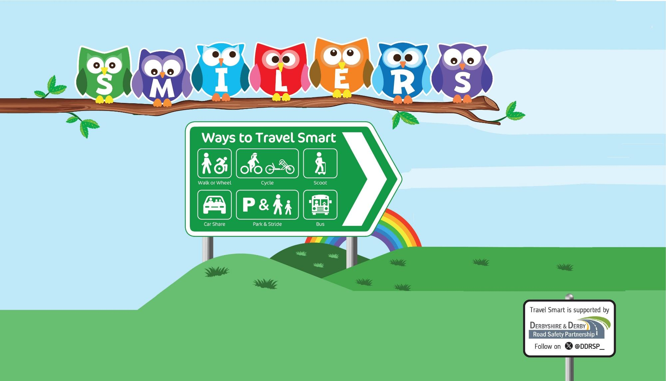
Follow the SMILERS ways of making active and environmentally friendly Travel Smart school journeys to boost your wellbeing,
support your community and help the planet!
Join us for Travel Smart week 20th –24th May 2024

Slide 2

Meet the SMILERS and their seven ways to wellbeing
Stay Connected
Interest
Eat well
Support
Move
Look
Rest

Slide 3
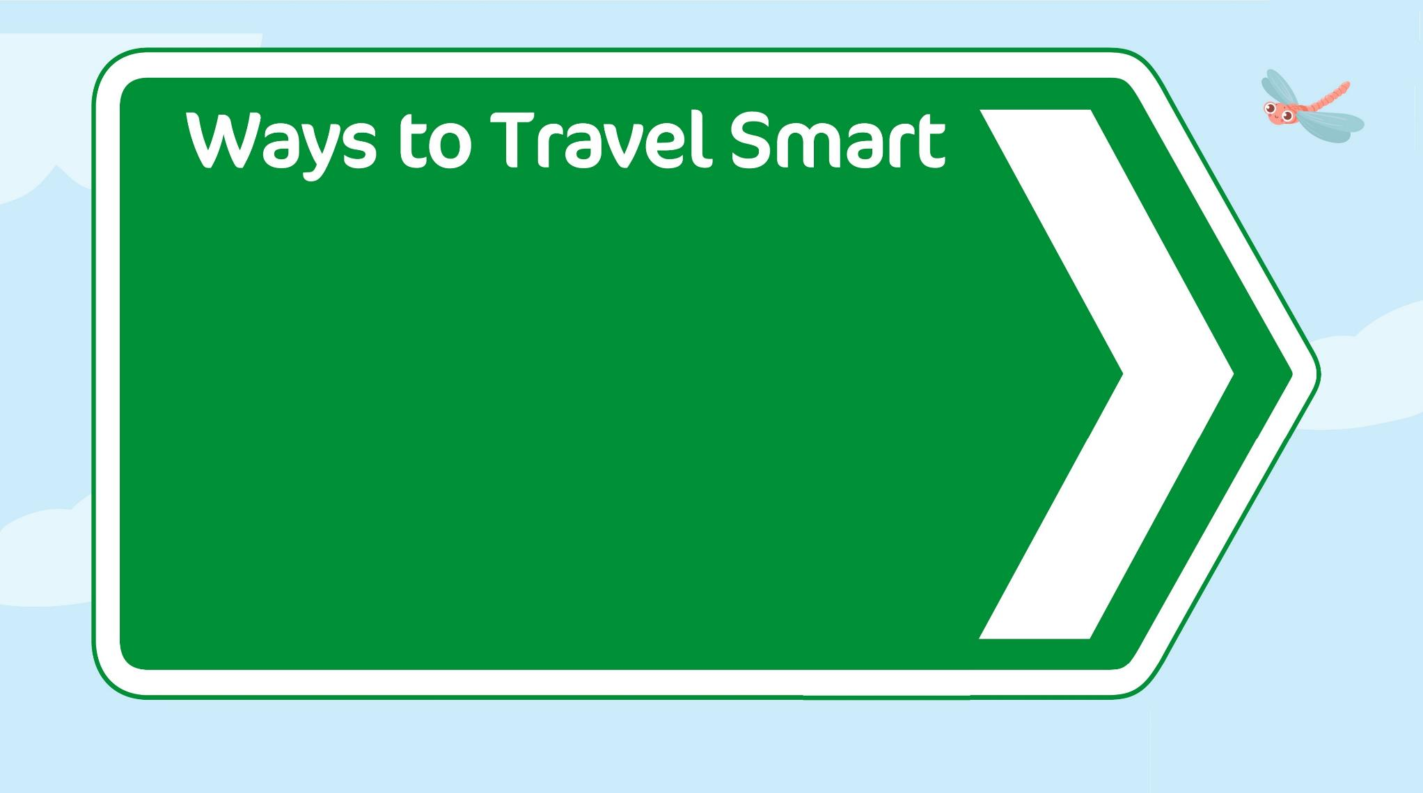
Ways to Travel Smart
Let’s find out how being Travel Smart each day can help boost wellbeing.

Slide 4
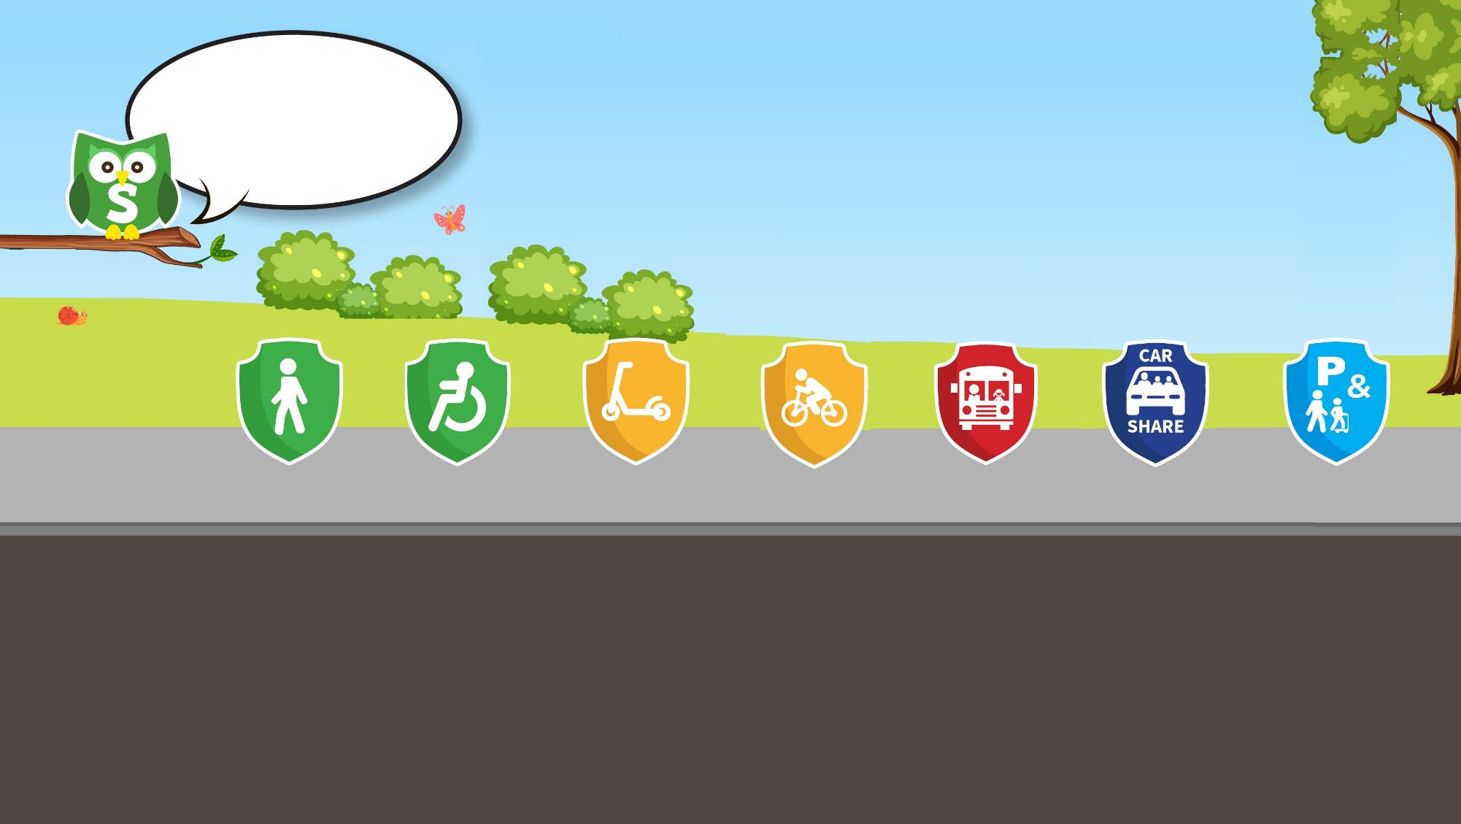
Stay Connected on Modeshift Monday
Think about how you will travel and who you might connect with on your school journey.
Having healthy relationships with people, pets and nature can help us to feel happier.
Travelling to and from school with friends and family is a great way to catch up and connect.
walk
wheel
scoot
cycle
bus
car share
Park and Stride
Think of ways to help keep yourself and others safe so that you are:

Slide 5
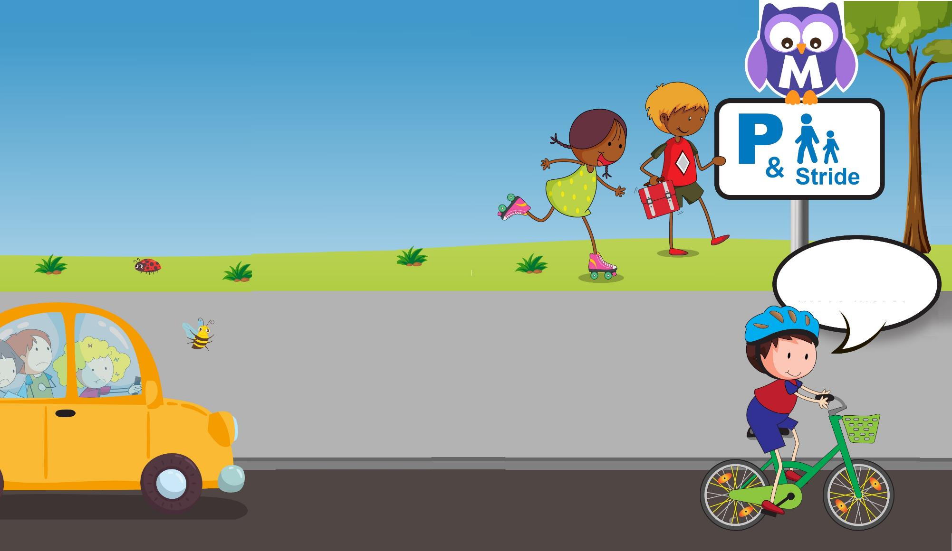
Move More on Traffic Free Tuesday
Being active can make you feel more awake and can improve your mood.
Active journeys also help to reduce the number of cars around school which helps to make the roads feel safer and the air cleaner.
How will you move more?
Even if you travel by car, the driver can ‘Park Smart’ by;
parking away from school, so you can walk the last distance,
as well as turning the engine off while they wait.
This also helps to improve air quality and cut carbon emissions.
Find out more at https://letsgozero.org/

Slide 6
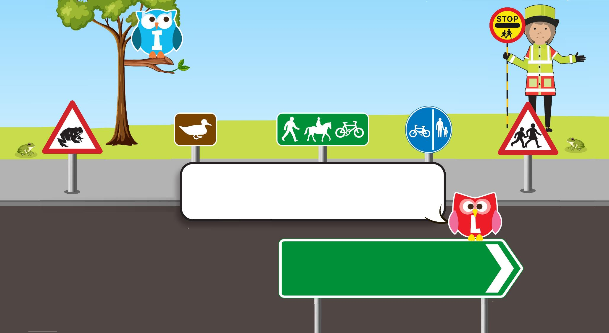

Look out for interesting things on
Wander and Wonder Wednesday
Having special interests and learning something new keeps your brain busy.
Using your senses to notice what is around you also helps to keep you in the moment and keep you safe.
On your journey look for signs that direct you to interesting places or which help to keep you safe.
Which of these have you seen and do you know what they mean?
Find out more about road signs and what the different shapes and colours mean at: www.think.gov.uk/resource/tales-of-the-road/

Slide 7

Eat well and rest on Feel Good Thursday
Maybe you could eat a traffic light for breakfast!
Eating a balanced diet can make you feel good
and can help you stay healthy and strong.
Getting a good night’s sleep can also improve your memory, mood and mental health.
Fuel yourself up for the journey
by resting well the night before,
so that you are up in time,
alert and wide awake
to travel actively and safely.

Slide 8
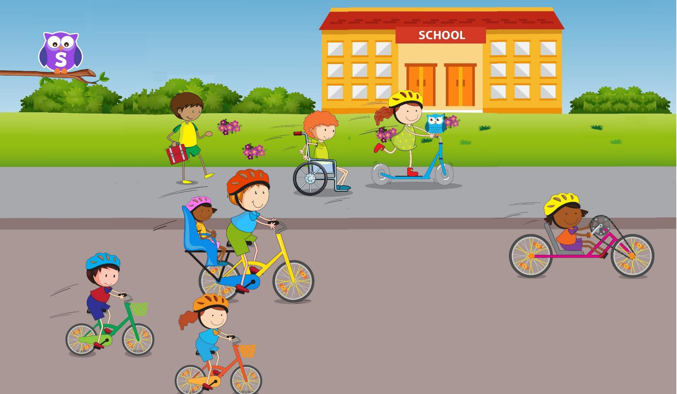
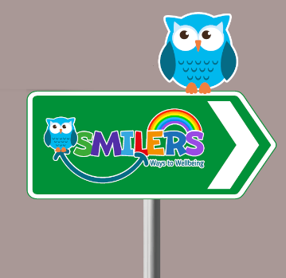
Support others on Thoughtful Friday
Thinking of others can make them feel happy and can make us feel good too.
Thinking of others by walking, wheeling, cycling and scooting to school means fewer cars on the road.
Fewer cars can make it easier to cross the road and easier for buses or emergency services
to get through if they need to.
Drivers can also support walkers and wheelers by not parking on the pavement or over driveways.
How can you Travel Smart to help make others around you happy?

Slide 9
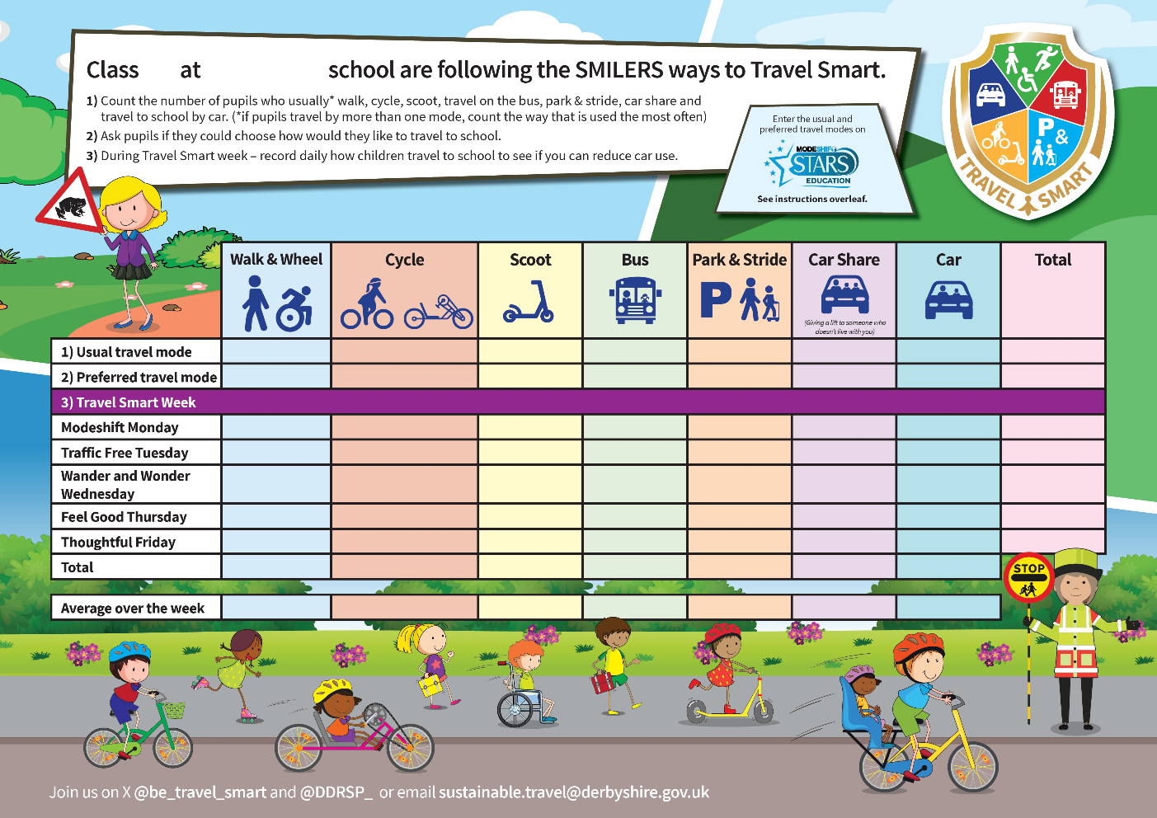
Have a great
Travel Smart
Week!
Remember to record your usual and preferred ways of travelling to school.
Which was your best Travel Smart day?
Could everyday be a Travel Smart day?

Slide 10
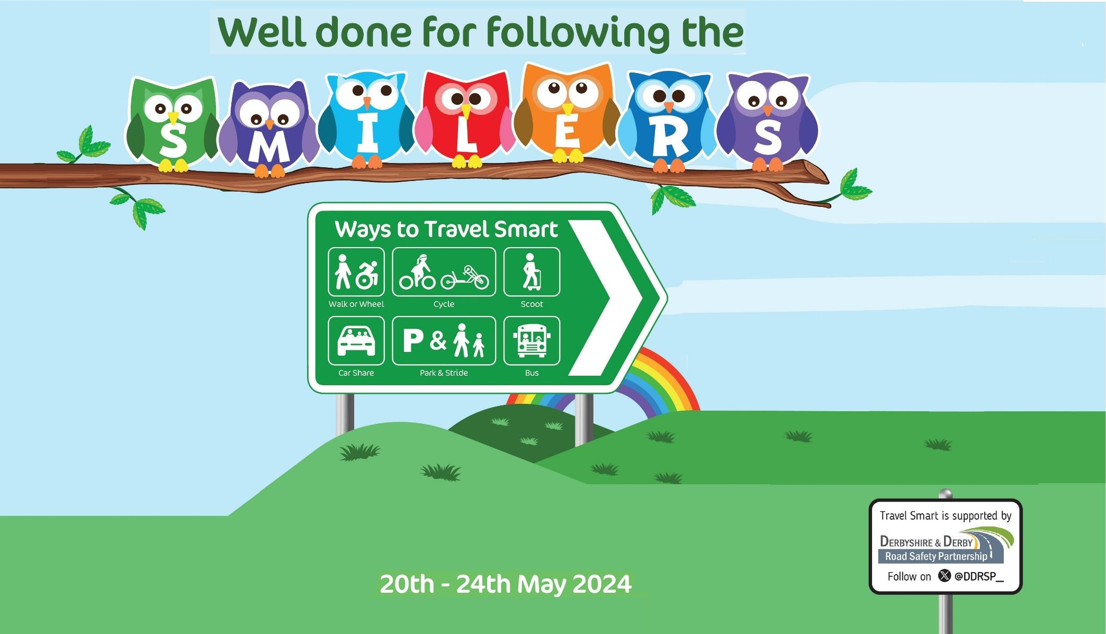
Well done
making active and environmentally friendly Travel Smart school journeys to boost your wellbeing, support your community and help the planet!

